Slide 1
Splay Tree
DATA STRUCTURE

Slide 2
Splay Tree is a self - adjusted Binary Search Tree in which every operation on element rearranges the tree so that the element is placed at the root position of the tree
Splay
All the operations in splay tree are involved with a common operation called "Splaying"
Splaying an element, is the process of bringing it to the root position by performing suitable rotation operations

Slide 3
How does it work?
〇 By splaying elements we bring more frequently used elements closer to the root of the tree so that any operation on those elements is performed quickly.
〇 Every operation on splay tree performs the splaying operation
〇 For example, the insertion operation first inserts the new element using the binary search tree insertion process, then the newly inserted element is splayed so that it is placed at the root of the tree.

Slide 4
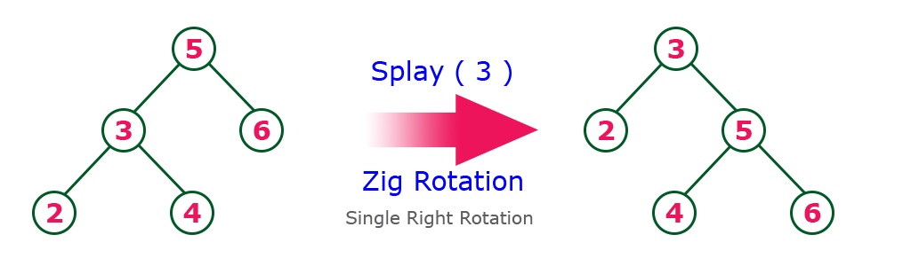
Zig Operation

Slide 5
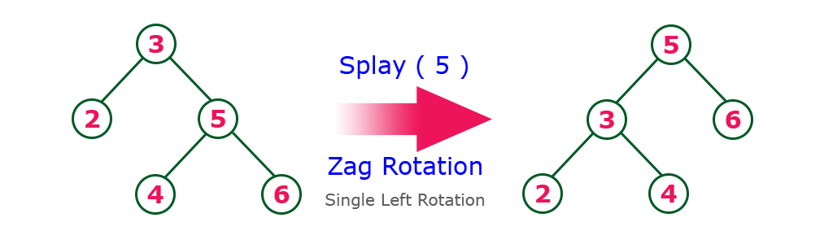
Zag Operation

Slide 6
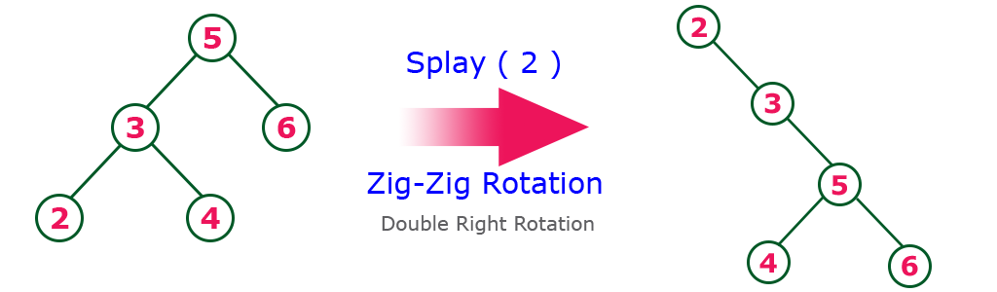
Zig-zig Operation

Slide 7
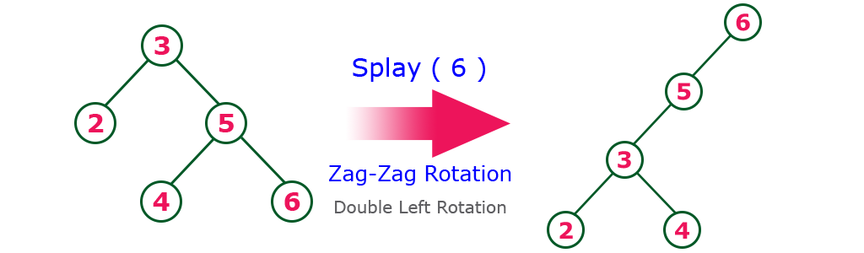
Zag-zag Operation

Slide 8
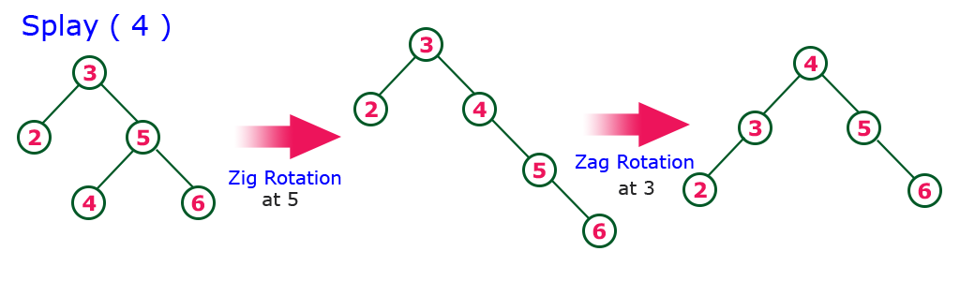
Zig-zag Operation

Slide 9
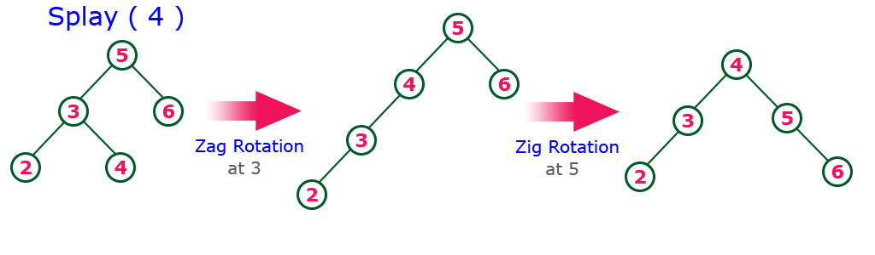
Zag-zig Operation

Slide 10
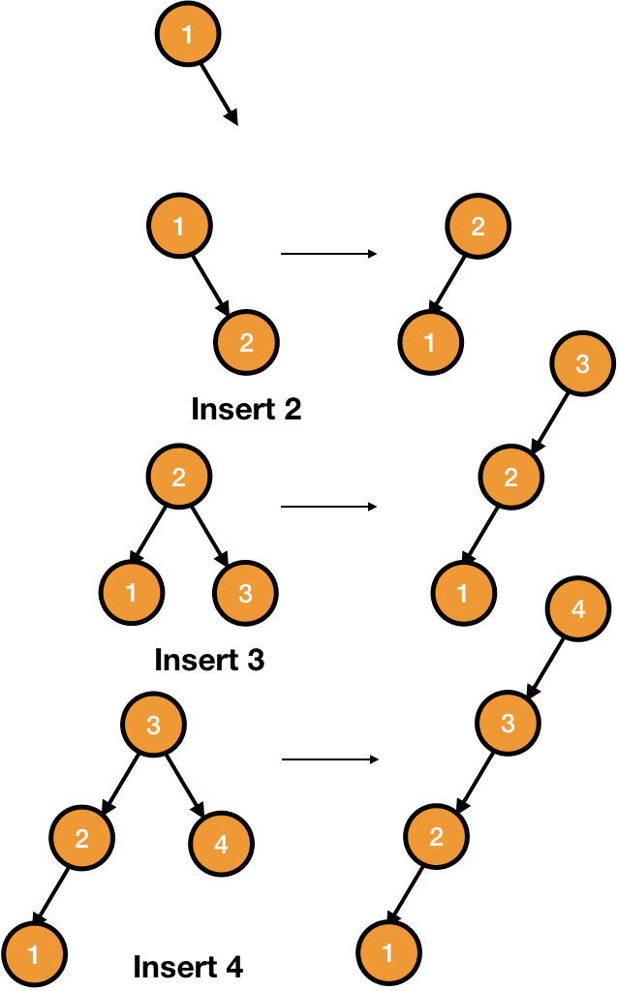
Insertion
Step 1 - Check whether tree is Empty.
Step 2 - If tree is Empty then insert the
newNode as Root node and
exit from the operation.
Step 3 - If tree is not Empty then insert
the newNode as leaf node using
Binary Search tree insertion logic.
Step 4 - After insertion, Splay the newNode
Search
The search operation in a splay tree is nothing but searching the element using binary search process and then splaying that searched element so that it is placed at the root of the tree.

Slide 11
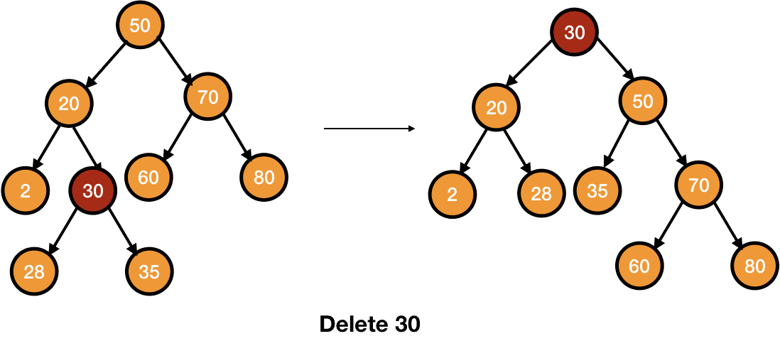
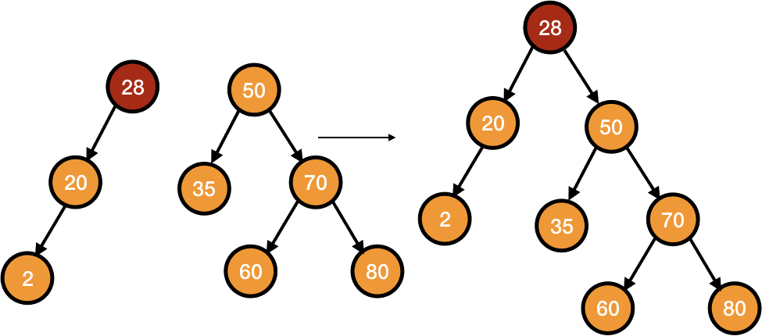
Deletion
To delete a node in a splay tree, we first splay that node to the root. After this, we just delete the root which gives us two subtrees. We find the largest element of the left subtree and splay it to the root. Lastly, we attach the right subtree as the right child of the left subtree

Slide 12
Complexity
All splay tree operations take O(log n) time on average.
Splay trees can be rigorously shown to run in O(log n) average time per
operation, over any sequence of operations (assuming we start from an empty tree)
The time complexity in the worst case is O(n).

Slide 13
Applications
A
Splay trees have become the most widely used basic data structure invented in the last 30 years
B
They are the fastest type of balanced search tree for many applications
C
Splay trees are used in Windows NT (in the virtual memory, networking, and file system code), the gcc compiler and GNU C++ library, the sed string editor, Fore Systems network routers, the most popular implementation of Unix malloc, Linux loadable kernel modules, and in much other software

Slide 14
Thank you
Al Hossain (2020-1-60-016)
Ishmam-ur-Rahman (2020-1-60-241)
K. M. Safin Kamal (2020-1-60-235)

